Slide 1

J&T EXPRESS. (NYSE: J&T)
Investment Memo
Group 4: Yang Xiaohan | Shang Zhou | Shen Mengjing | Wang Aocheng | Wang Bingjie | Li Hangyu | Zou Jie
Jan. 10th 2024

Slide 2
Investment Recommendation
Market Overview
1
2
Rating | Name | J&T Express
HOLD | Ticker | J&T
 | Target Price | 2.36 USD
 | Closing Price | 1.99 USD
Shares Outstanding:
ADS 8812.17M
52-week Range:
USD 1.37-2.06
Market Capitalization:
USD 175.36 Billion
3
Financial Summary
 | 2020A | 2021A | 2022A | 2023E | 2024E | 2025E
Revenue (USD, Million) | 1,535.43 | 4,859.71 | 7,267.43 | 8,479.00 | 10,062.00 | 12,578.00
YoY(%) | - | 216.50% | 49.54% | 16.67% | 18.67% | 25.00%
EBIT (USD, Million) | -612.36 | -6,040.66 | 1,649.71 | -412.73 | -375.84 | 10.34
ROE | 74.40% | 91.75% | -34.17% | -5.40% | -5.70% | 0.1%
EPS | -0.95 | -11.76 | 2.74 | -0.05 | -0.05 | 0.0005

Slide 3

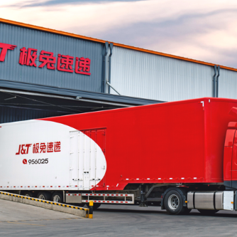
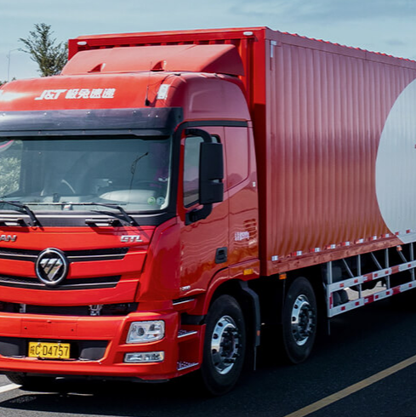
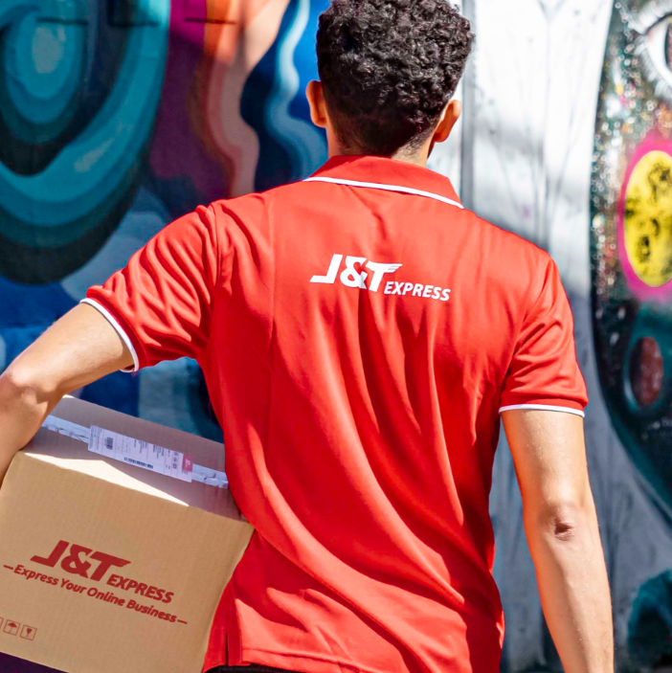
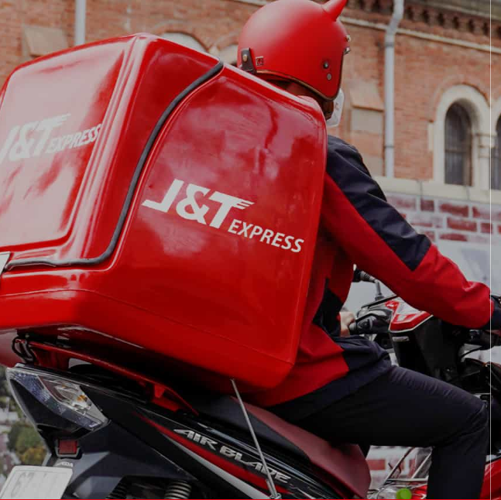
J&T Express is A Global Logistics Company
J&T Express was founded by Mr. Li Jie in 2015, and was listed in 2023.
J&T Express’s express network includes Indonesia, Vietnam, Malaysia, Philippines, Thailand, Cambodia, Singapore, China, Saudi Arabia, UAE, Mexico, Brazil and Egypt.
Since its inception, it has established a express network in 13 countries, operating 280 large transfer centers, more than 21,000 outlets, and serving more than 400,000 people. Polar Rabbit serves the largest and fastest growing e-commerce market in the world, with leading positions in Southeast Asia and China.
Source: Company Website

Slide 4
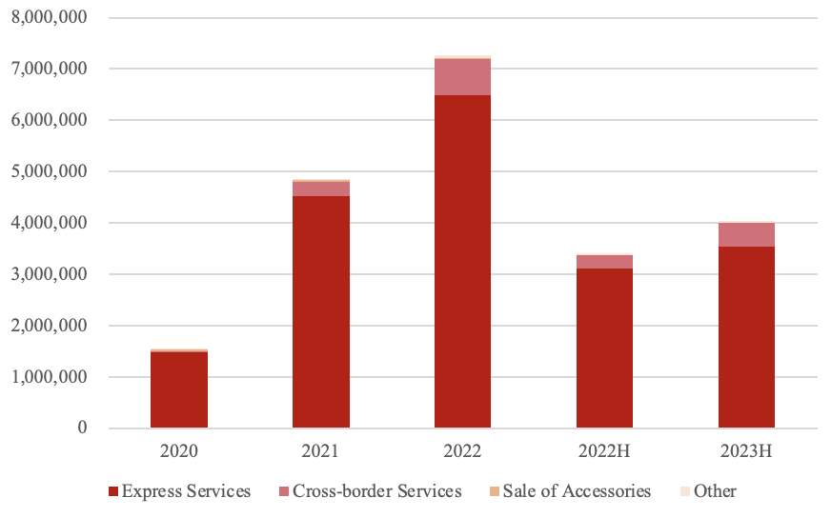
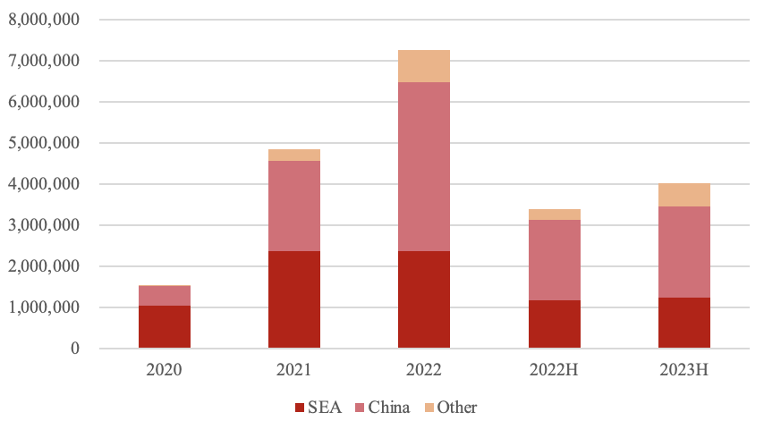
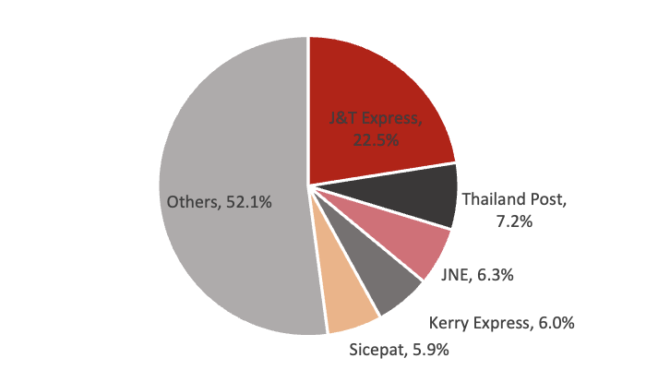
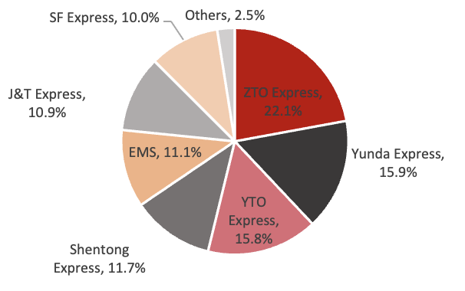
Overview
Business Layout
Strategical Highlights
1
2
Primary Business: Express Delivery Services.
Regional Expansion: Originated in SEA and rapidly growing in China.
Outstanding Managerial Capabilities
Founder Li Jie established J&T Express in Indonesia, with over 15 years of prior professional experience at OPPO.
The current management team consists largely of members from BBG and OPPO, creating a integrated corporate culture.
J&T benefits from resources of PDD.
Unique Regional Agency Methods
Regional agents hold the operational entities of the company‘s corresponding express network. They are familiar with local environment and therefore could better contribute to the company's rapid expansion.
Pioneering Global Network
J&T Express has grown alongside the global journey of Chinese cross-border e-commerce, facilitating the expansion of Chinese manufacturing and brands into global markets.
With the B&R Initiative, the international trade market continues to expand, presenting opportunities for emerging economies.
3
Market Overview
Express Industry: Early Stage and Fast Developing
Growth in Purchasing Power | Per Capita GDP is expected to increase from $6,216.9 in 2023 to $8,143.1 in 2027, CAPR 7.0%
Improvement of Infrastructure | The improvement of transportation systems has enhanced the quality, coverage, and timeliness of express delivery services. E-Commerce platforms are gradually gaining acceptance.
Favorable Government Policies | ‘the Logistics and Trade Facilitation MasterPlan’, ‘Digital Indonesia Roadmap 2021-2024’, B&R Initiative, RECP, etc.
4
Competition Landscape
SEA
China
Source: Annual Report, Company Website, Prospectus, Frost &Sullivan

Slide 5
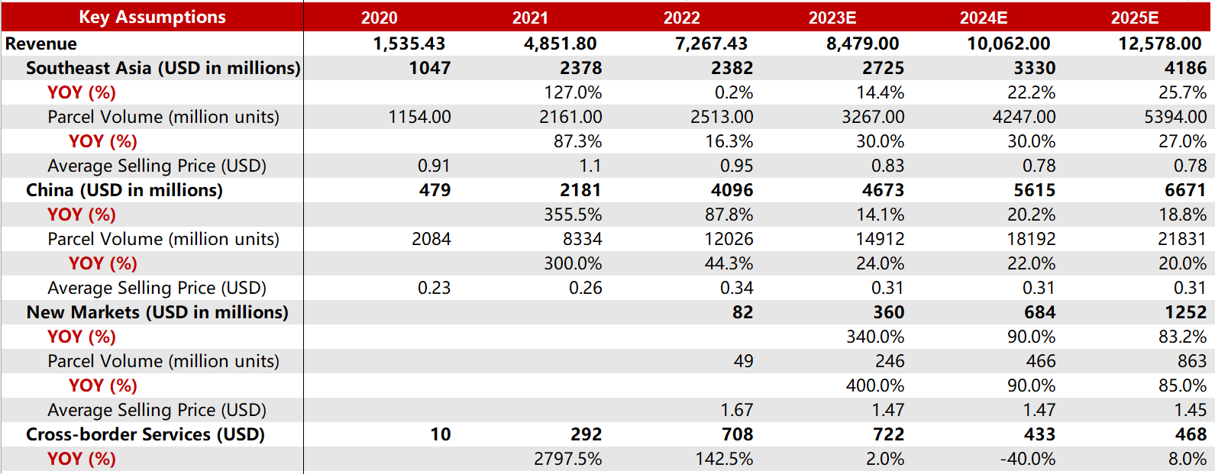
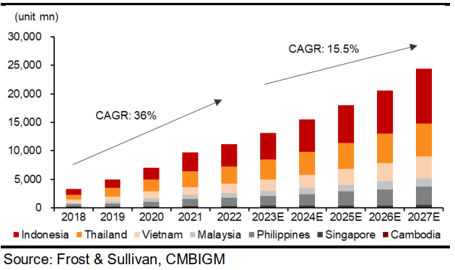
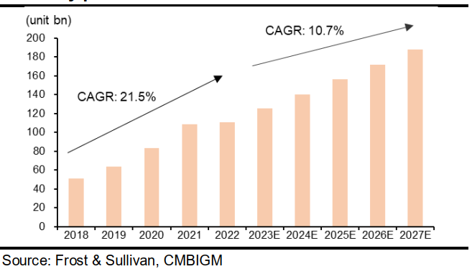
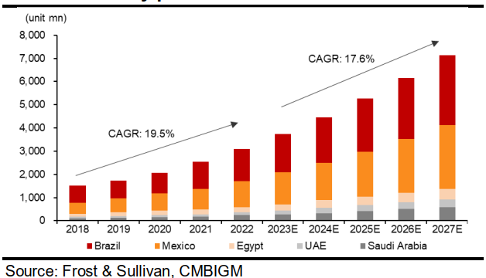
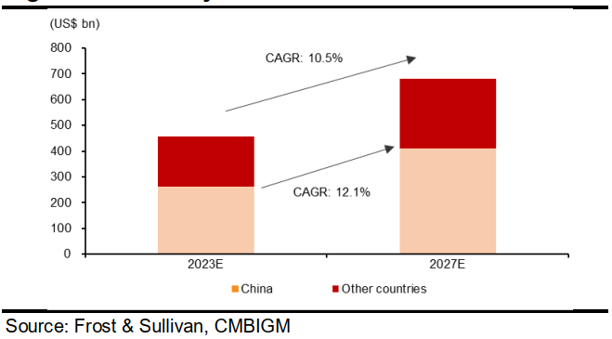
Sales Forecasts: Explanations About Key Assumptions
Southeast Asia
Assumption
Parcel Volume: We forecast parcel volume to grow at 30%, 30%, 27% in 2023E-2025E, driven by continuous market share gains in regions.
Average Selling Price: Considering the storage construction and management costs fell, it is expected to show a downward trend in the next 2 years.
Rational:
+: Infrastructure improvement, Rise of per capita GDP, Chinese enterprise expansion
–: Penetration of smart phone and Internet, operational challenges due cultural differences
Figure: Market size of express delivery market in SEA by parcel volume
Figure: Market size of express delivery market in China by parcel volume
China
Assumption
Parcel Volume: We forecast parcel volume to grow at 24%, 22%, 22% in 2023E-2025E, higher than the industry growth as we expect the company to put more focus on market share.
Average Selling Price: We forecast the ASP to see a high single-digit decrease in 2023E, followed by a stabilization in 2024E-25E (driven by lower unit cost).
Rational:
+: Scale effect, Increasing e-commerce retail penetration, Consumption recovery after epidemic
–: Fierce industry competition, Price war of express industry
Figure: Market size of express delivery market in New Markets by parcel volume
Figure: Market size of global and China cross-border logistics market by transaction value
New Markets
Assumption:
Parcel Volume: We forecast New Markets to contribute high parcel volume growth in 2023E, up 4x YoY due to a low base. We forecast 90%/85% parcel volume growth in 2024E/25E, driven by strong growth in regions such as Brazil and the Middle East.
Average Selling Price: The average selling price remain stable.
Rational:
+: Transition period to online shopping, Chinese enterprise expansion
–: Political and economic risk, operational challenges due cultural differences
Source: Annual Report, Trefis, St. Louis Federal Reserve’s website
Notes:
J&T Global's business relies heavily on the growth of the e-commerce industry as it provides express delivery services to e-commerce platforms and merchants.
Bolstered by regional sponsors' resources and experience, the Company is well-positioned to connect the marketplaces and merchants to New Markets, while achieving the reduction of capital expenditure.

Slide 6
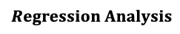

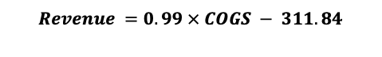
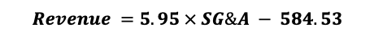
Projecting Income Statement
$$Regression Analysis$$
Run a regression of historical costs versus sales
Use ANOVA to assisting determination
$$Revenue =0.99 × COGS − 311.84$$
Gross Profit =Total revenue - COGS
Gross margin
Historical data has risen steadily and remained at about -11.21% at FY21, and -3.71% at FY22.
Rational: higher shipping price, raw packaging material costs, increased promotional activity.
$$Revenue =5.95 × SG\&A − 584.53$$
Other expense = Other expense as % of COGS $×$ COGS
Other expense as % of COGS
Almost stable ≈ 0.8%.
Source: Annual Report

Slide 7
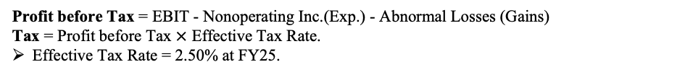
Projecting Income Statement
EBIT = Gross Profit – SG&A – Other Expense.
-1030.59 at FY25.
EBIT Margin
Projecting ≈ 8.19%.
Non-operating Income. (Expense.)
Interest and Invest Income, Interest Expense, Other Non-Operating Inc. (Exp.): Almost constant.
Income(Loss) from Affiliates, Currency Exchange Gains (Loss) : are ignored
Abnormal Losses (Gains)
Asset Writedown, Other Unusual Items: Almost constant.
Restructuring Charges, Merger/Acquisition Expense, Legal Settlement, Impairment of Goodwill, Gain (Loss) On Sale Of Invest.: are ignored
Profit before Tax = EBIT - Nonoperating Inc.(Exp.) - Abnormal Losses (Gains)
Tax = Profit before Tax $×$ Effective Tax Rate.
Effective Tax Rate = 2.50% at FY25.
Net Income = Net Income from cont. operations = Net Income to Company.
Net Extraordinary Losses (Gains) and Minority Int. in Earnings: are ignored.
Projecting: -441.27 at FY23 to 4.39 at FY25.
Net Income Margin
Projecting: from -5.20% at FY23 to 0.03% at FY25.
Depreciation = Accumulated Depreciation_{t} - Accumulated Depreciation_{t-1}
Amortization = Other Intagibles_{t-1} – Other Intagibles_{t}
adopt the historical and projecting terms in B/S.
EBITDA = EBIT + Depreciation + Amotization
Projecting: 73.27 at FY23 to 483.34 at FY25.
EBITDA margin
Projecting: around -0.3% from FY23 to FY25.
Source: Annual Report

Slide 8
Projecting Income Statement
Source: Annual Report

Slide 9
Projecting Balance Sheet
Balance Sheet
(USD in millions)
 |  | 2020 | 2021 | 2022 | 2023E | 2024E | 2025E
Current assets:
Cash And Equivalents |  | 600.43 | 2,102.45 | 1,504.05 | 14,905.11 | 14,448.64 | 14,483.35
Trading financial assets |  | 71.32 | 41.58 | 16.44 | 16.44 | 16.44 | 16.44
Other short-term investments |  | 319.01 | 63.52 | 1.67 | 1.67 | 1.67 | 1.67
Accounts & Notes Receivable |  | 180.76 | 334.88 | 513.95 | 661.26 | 745.30 | 941.06
Other receivables |  | 426.36 | 818.67 | 701.34 | 822.46 | 965.95 | 1,204.97
Inventory |  | 15.95 | 29.36 | 29.12 | 29.03 | 33.68 | 39.88
Other Current Assets |  | 0.93 | 125.97 | 79.73 | 93.02 | 110.38 | 134.58
Total Current Assets |  | 1,614.75 | 3,516.42 | 2,846.30 | 16,528.99 | 16,322.07 | 16,821.97
Non Current Asset:
Net Fixed Assets |  | 301.86 | 1,076.11 | 993.94 | 966.94 | 962.94 | 821.25
Equity Investments |  | 0.32 | 5.55 | 3.59 | 3.59 | 3.59 | 3.59
Debt Instruments |  | 0.00 | 0.00 | 0.00 | 0.00 | 0.00 | 0.00
Debt Instruments |  | 0.00 | 0.00 | 0.00 | 0.00 | 0.00 | 0.00
Other Long-Term Investments |  | 112.06 | 149.14 | 518.99 | 523.99 | 523.99 | 523.99
Goodwill and Intangible Assets |  | 192.09 | 1,730.27 | 1,442.31 | 1,442.31 | 1,442.31 | 1,442.31
Leased Land |  | 1.85 | 34.59 | 61.42 | 61.42 | 61.42 | 61.42
Other Non-Current Assets |  | 20.10 | 32.55 | 69.03 | 62.52 | 62.52 | 62.52
Total Non-Current Assets |  | 628.29 | 3,028.22 | 3,089.26 | 3,060.76 | 3,056.76 | 2,915.07
Total Assets |  | 2,243.04 | 6,544.64 | 5,935.56 | 19,589.74 | 19,378.83 | 19,737.03
Key Ratios
Asset
Cash And Equivalents / Revenue |  | 0.39 | 0.43 | 0.21 | 1.75 | 1.48 | 1.23
Short Term Investments / Revenue |  | 0.25 | 0.02 | 0.00 | 0.00 | 0.00 | 0.00
Receivable turnover |  | 8.49 | 14.51 | 14.14 | 12.88 | 13.11 | 12.53
Current Assets
Cash And Equivalents：Average of [cash and cash equivalents/revenue ratio] in the past 3 years * Forecast revenue for the current year
Other Short Term Investments：Average of [other short-term investment/revenue ratio] in the past 3 years * the forecast revenue of the current year
Accounts & Notes Receivable：The forecast revenue of the current year / (the average of the past 3 years [accounts receivable turnover rate] ) *2- accounts receivable of last year
Inventory：(COGS/ average of the past 3 years 【inventory turnover rate】) *2- Last year's inventory
Non-Current Assets
Net Fixed Assets: (the average of the last 3 years (Net Fixed Assets growth rate) +1)* Total Net Fixed Assets of last year
Equity Investments: (the average of the past 3 years [accumulated depreciation/total PPE of the previous year ratio]) * the predicted total PPE of the previous year
Other Long-Term Investments : the average of the past 3 years
Goodwill and Intangible Assets: Average Goodwill and Intangible amortization ratio in the past 3 years * Goodwill and Intangible of last year + Goodwill and Intangible of last year
Leased Land : (Average amortization rate of leased land over past 3 years) * value of leased land of last year
Source: Annual Report

Slide 10
Projecting Balance Sheet
Projecting Balance Sheet
Current Liabilities
Balance Sheet
(USD in millions)
 |  | 2020 | 2021 | 2022 | 2023E | 2024E | 2025E
Current Liabilities：
Accounts Payable and Notes Payable |  | 225.45 | 577.07 | 484.22 | 483.74 | 558.01 | 659.72
Taxes Payable |  | 24.28 | 48.83 | 41.00 | 42.40 | 43.27 | 45.28
Financial Liabilities at Fair Value through Profit or Loss |  | 0.00 | 0.00 | 0.00 | 0.00 | 0.00 | 0.00
Short-term Borrowings |  | 407.14 | 59.97 | 77.48 | 95.00 | 112.51 | 130.03
Other Current Liabilities |  | 490.14 | 1,519.88 | 1,128.92 | 1,187.06 | 1,341.26 | 1,583.57
Total Current Liabilities |  | 1,147.02 | 2,205.74 | 1,731.62 | 1,808.19 | 2,055.05 | 2,418.60
Non-Current Liabilities：
Long-term Debt |  | 36.92 | 29.06 | 1,020.90 | 1,020.90 | 1,020.90 | 1,020.90
Other Non-Current Liabilities |  | 1,929.60 | 10,946.27 | 8,167.29 | 8,670.93 | 8,670.93 | 8,670.93
Total Non-Current Liabilities |  | 1,966.52 | 10,975.33 | 9,188.19 | 9,691.83 | 9,691.83 | 9,691.83
Total Liabilities |  | 3,113.54 | 13,181.07 | 10,919.81 | 11,500.02 | 11,746.88 | 12,110.42
Equity：
Preferred Stock |  | 0.01 | 0.01 | 0.01 | 0.01 | 0.01 | 0.01
Treasury Stock |  | 0.00 | 0.00 | 0.00 | 0.00 | 0.00 | 0.00
Common Stock |  | 0.00 | 0.00 | 0.00 | 13,543.32 | 13,543.32 | 13,543.32
Reserves |  | -745.81 | -6,564.62 | -4,573.60 | -5,024.59 | -5,480.83 | -5,486.16
Other |  | -13.43 | -26.40 | -273.44 | -273.44 | -273.44 | -273.44
Equity Attributable to Owners of the Parent |  | -759.23 | -6,591.01 | -4,847.03 | 8,245.30 | 7,789.06 | 7,783.73
Minority Interest |  | -111.27 | -45.41 | -137.22 | -155.58 | -157.11 | -157.12
Total Equity |  | -870.50 | -6,636.42 | -4,984.25 | 8,089.73 | 7,631.95 | 7,626.61
Total Liabilities and Equity |  | 2,243.04 | 6,544.64 | 5,935.56 | 19,589.74 | 19,378.83 | 19,737.03
Working Capital |  | 203.13 | -773.38 | -328.33 | -105.75 | -85.55 | 33.61
Debt to Asset Ratio |  | 139% | 201% | 184% | 59% | 61% | 61%
Interest-bearing Debt |  | 444.06 | 89.03 | 1,098.38 | 1,115.89 | 1,133.41 | 1,150.92
Interest-bearing Debt Ratio |  | 14% | 1% | 10% | 10% | 10% | 10%
Non-core Assets |  | 784.13 | 2,298.73 | 2,043.06 | 15,449.12 | 14,992.65 | 15,027.37
Invested Capital (IC) |  | -426.44 | -6,547.40 | -3,885.87 | 9,205.62 | 8,765.36 | 8,777.53
Accounts Payable and Notes Payable : COGS/ average of the past 3 years [accounts payable turnover rate]
Taxes Payable : Total Annual Operating Expenses / average of the past 3 years of accrued expenses
Curr. Port. of LT Debt、 Curr. Port. of Leases 、 Other Current Liabilities : average of the past 3 years
Non-Current Liabilities
Long-Term Borrowings、Long-Term Leases、Other Non-Current Liabilities: average of the past 3 years
Equity
Common Stock: Expected to remain unchanged
Reserves : (1+ average growth rate in the past 3 years) * APIC last year
Treasury Stock: According to the past growth rate, the annual growth rate is expected to be 2% in 1-5 years and 4% in 6-10 years
Equity Attributable to Owners of the Parent : Residual term
Minority Interest: Net income of subsidiary × Minority ownership percentage
Source: Annual Report

Slide 11
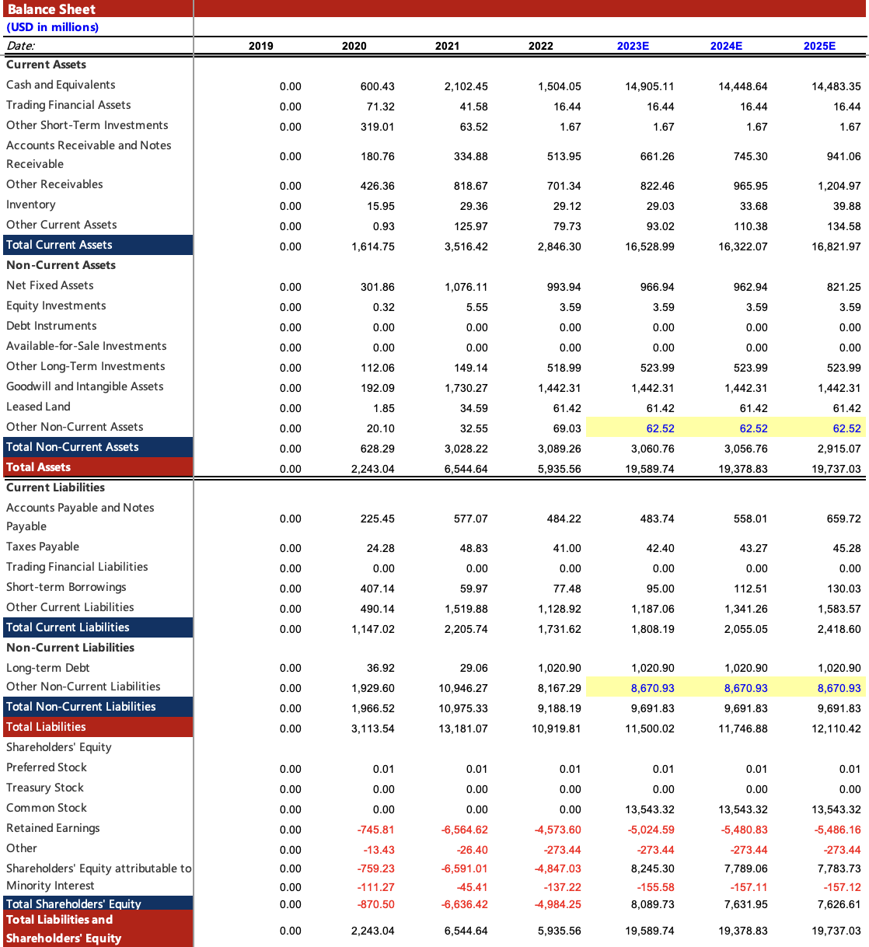
Balance Sheet：Prediction Results
Source: Annual Report

Slide 12
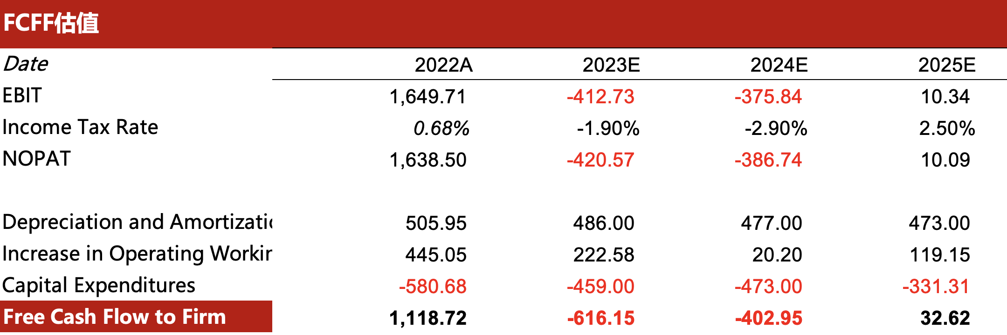

Firm Valuation: Projecting Cash Flows

Slide 13
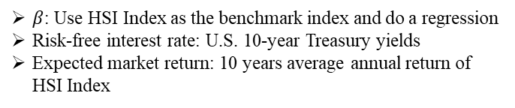
Firm Valuation: Estimation of WACC & Stock Price
WACC Buildup
Risk free rate |  |  | 4.06%
Equity risk premium |  |  | 7.88%
Beta |  |  | 0.556
Cost of equity |  |  | 8.44%
Cost of debt |  |  | 3.53%
Effective tax rate |  |  | 0.68%
Cost of debt * (1-T) |  |  | 3.5%
Book equity/(Debt + Equity) |  |  | 88.79%
Debt /(Debt + Equity) |  |  | 11.21%
WACC |  |  | 7.89%
Enterprise value
Net Present value |  |  | -2,209.8
Forecast Value
Perpetual growth rate |  |  | 10.0%
Present Value of FCFF |  |  | -849.1
FCFF Present value of sustainable value |  |  | -1,360.7x
Firm value |  |  | -2,209.8
Value of non-core assets |  |  | 1,808.7
Interest-bearing debt |  |  | 1,162.4
Minority interest |  |  | -226.3
Equity Value |  |  | -1,337.1
General capital |  |  | 8,812.2
EPS |  |  | -0.15
Revenue |  | 2022A | 7,267.43
Stock price |  | 2023/12/31 | 2.02
Revenue per share |  |  | 0.82
P/S |  |  | 2.45
Revenue |  | 2023E | 8,479.00
Revenue |  | 2024E | 10,062.00
Revenue |  | 2024E | 12,578.00
Stock price |  | 2023E | 2.36
Stock price |  | 2024E | 2.80
Stock price |  | 2025E | 3.50
Rating | Name | J&T Express
HOLD | Ticker | J&T
 | Target Price | 2.36 USD
 | Closing Price | 1.99 USD
Brief discussion
The firm value was underestimated.
The company occupies the first place in the Southeast Asian market and actively develops the business in Saudi Arabia, Latin America and Africa.
The Southeast Asian market is expected to grow at a CAGR of 15.5% in parcel volume from 2023 to 2027, with further growth expected in the express markets of Saudi Arabia, UAE, Mexico, Brazil and Egypt from 2023 to 2027. Compound annual growth rates were 20.6%, 21.0%, 18.7%, 16.1% and 15.3%, respectively.
Cost of equity: CAPM
$β$: Use HSI Index as the benchmark index and do a regression
Risk-free interest rate: U.S. 10-year Treasury yields
Expected market return: 10 years average annual return of HSI Index
Cost of debt
The actual borrowing rate of SF Holding, a comparable company in the same industry
Leverage
Debt: add the book value of debt reported in the balance sheet
Equity: market value of the outstanding stock

Slide 14
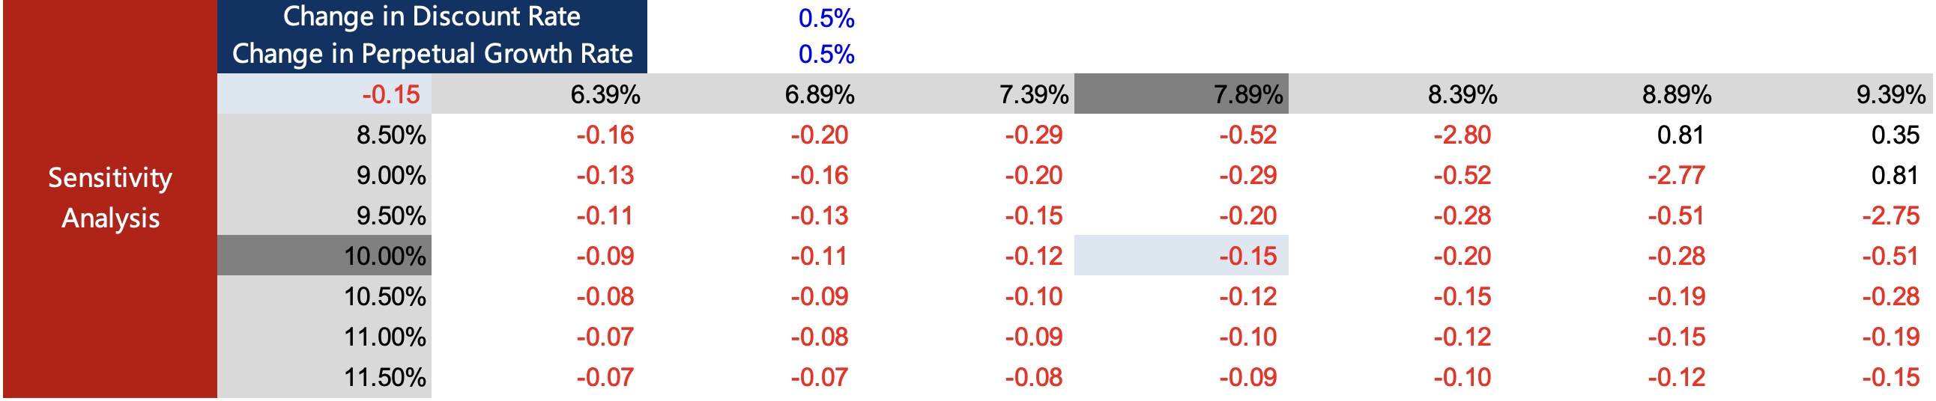
Sensitivity Analysis
WACC Sensitivity Analysis
Perpetual Growth Rate Sensitivity Analysis
Source: Annual Report

Slide 15

Ralph
For Whom the Bell Rings

